Slide 1
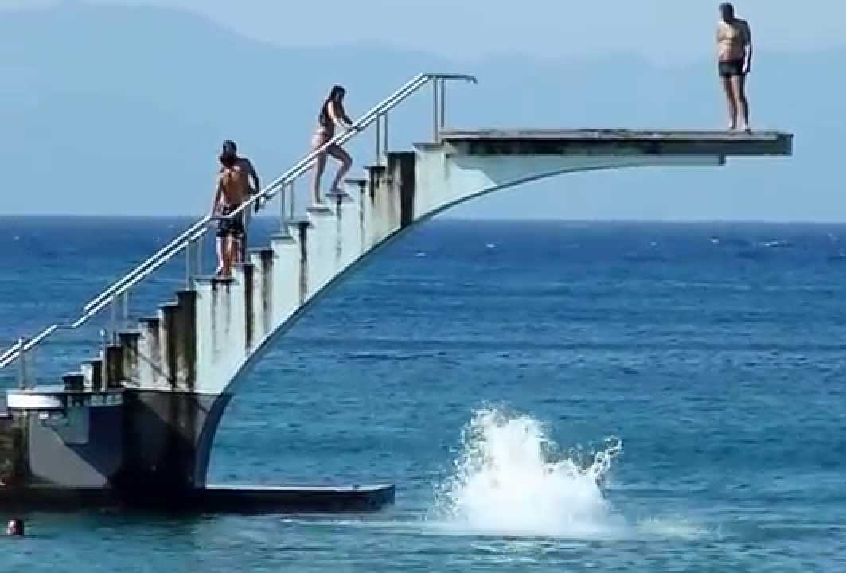
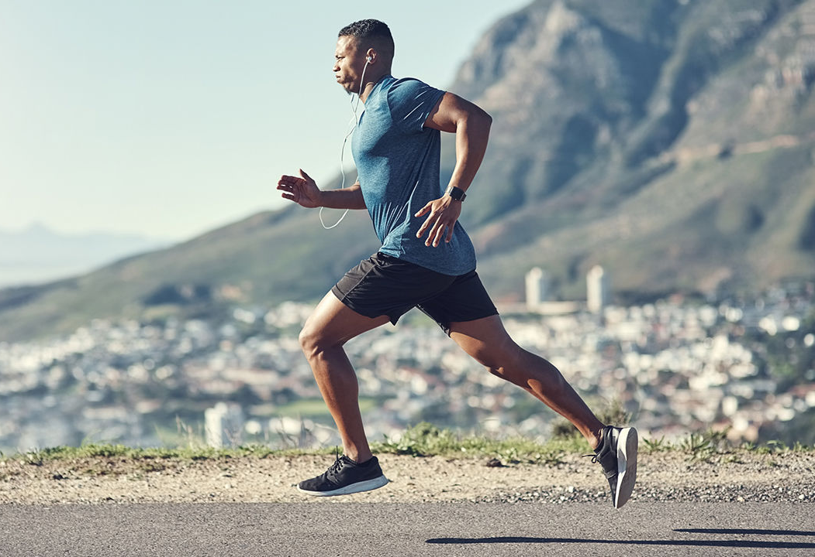
Daily Review
CFU 1
Which type(s) of energy are present in each situation below? Give a reason for your choice. A basket ball rolling across the ground. A skydiver jumping out of a plane. Your pencil case sitting on your desk.
Gravitational Potential Energy (GPE) and Kinetic Energy (KE)
Gravitational potential energy (GPE) is energy stored in objects above the Earth’s surface.
Kinetic energy (KE) is the energy possessed by moving objects.

Slide 2
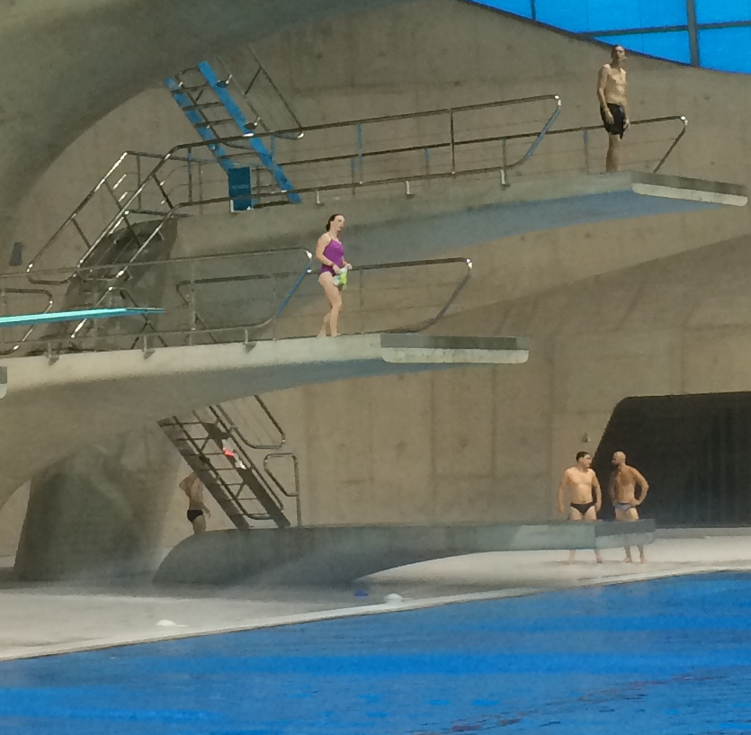
Daily Review
Reminder:
Gravitational potential energy is energy stored in objects above the Earth’s surface
CFU 1
What is the relationship between height and the amount of GPE?
Factors Affecting GPE
As an object is raised higher above the Earth’s surface, it gains more potential energy.
An object with a large mass has more GPE than an object with a small mass.
CFU 2
What is the relationship between mass and the amount of GPE?
CFU 3
Which person in the image will have the most GPE? Explain why.

Slide 3
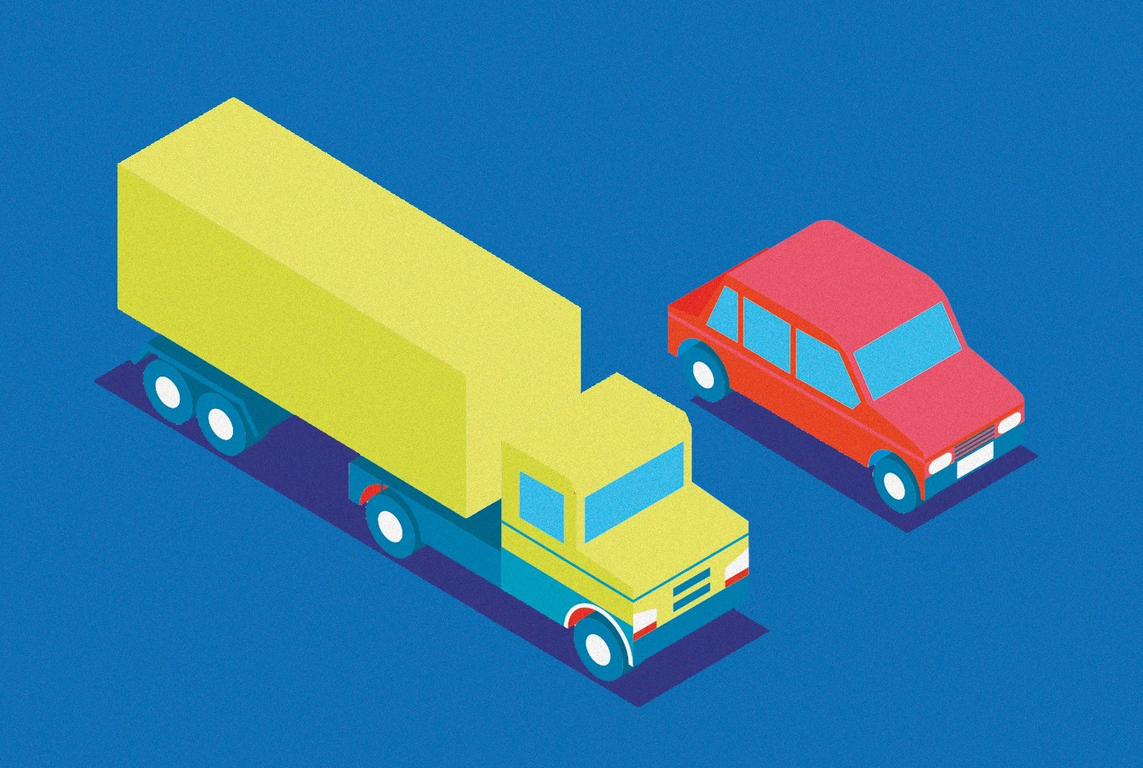
Daily Review
Reminder:
Kinetic energy is the energy possessed by moving objects
CFU 1
What is the relationship between kinetic energy and mass?
Factors Affecting KE
The amount of kinetic energy an object possesses is determined by the velocity of the object.
Objects travelling at a higher velocity have more kinetic energy.
Objects with a larger mass have more kinetic energy.
CFU 2
When moving at the same velocity, which would have more kinetic energy: a car or a truck?

Slide 4
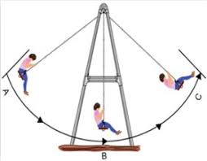
Daily Review
Draw a flow diagram to show the energy changes in the diagram of the girl on the swing.
At position A, she has maximum GPE and zero KE
At position B, she has minimum GPE and maximum KE
At position C, she has maximum GPE and zero KE

Slide 5
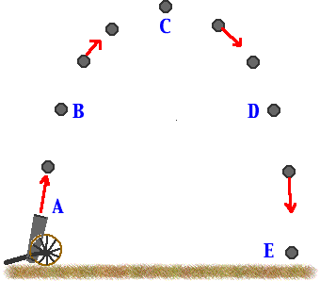
Skill Development/Guided Practice
Draw a flow diagram to show the energy changes in the diagram of the cannon ball being fired out of a cannon.
At position A, the ball has low GPE and maximum KE
At position B, the ball has increasing GPE and decreasing KE
At position C, the ball has maximum GPE and zero KE
At position D, the ball has decreasing GPE
and increasing KE
At position E, the ball has zero GPE and maximum KE

Slide 6
Potential and Kinetic Energy Calculations Part 1 Year 10 Physics

Slide 7
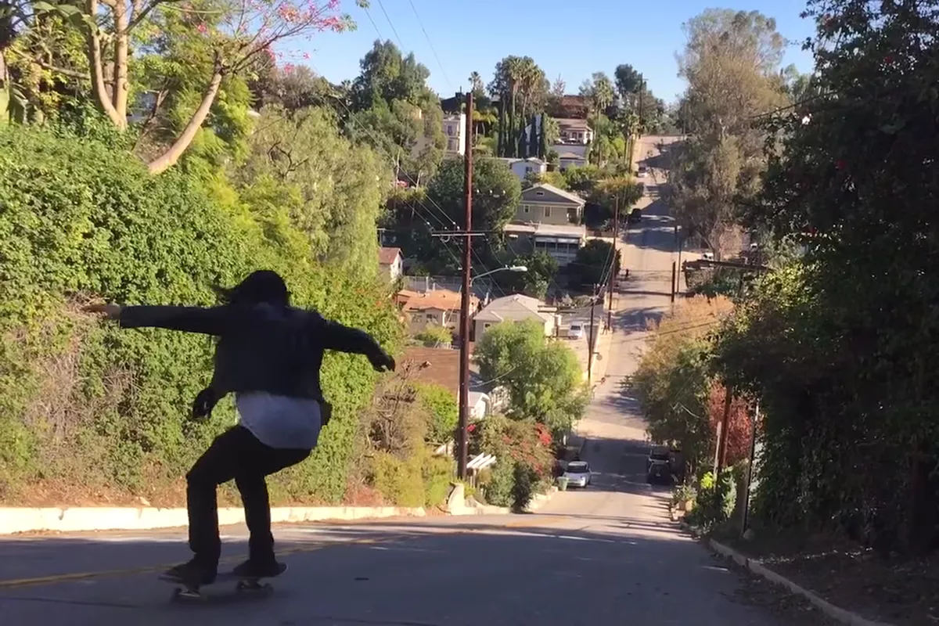
Learning Objectives
CFU
What are we going to learn?
Calculate the gravitational potential energy and kinetic energy in objects.
Activate Prior Knowledge
As an object falls, its gravitational potential energy is transformed into kinetic energy.
Think, pair, share: What happens to the velocity of the skater as they coast down the hill?

Slide 8
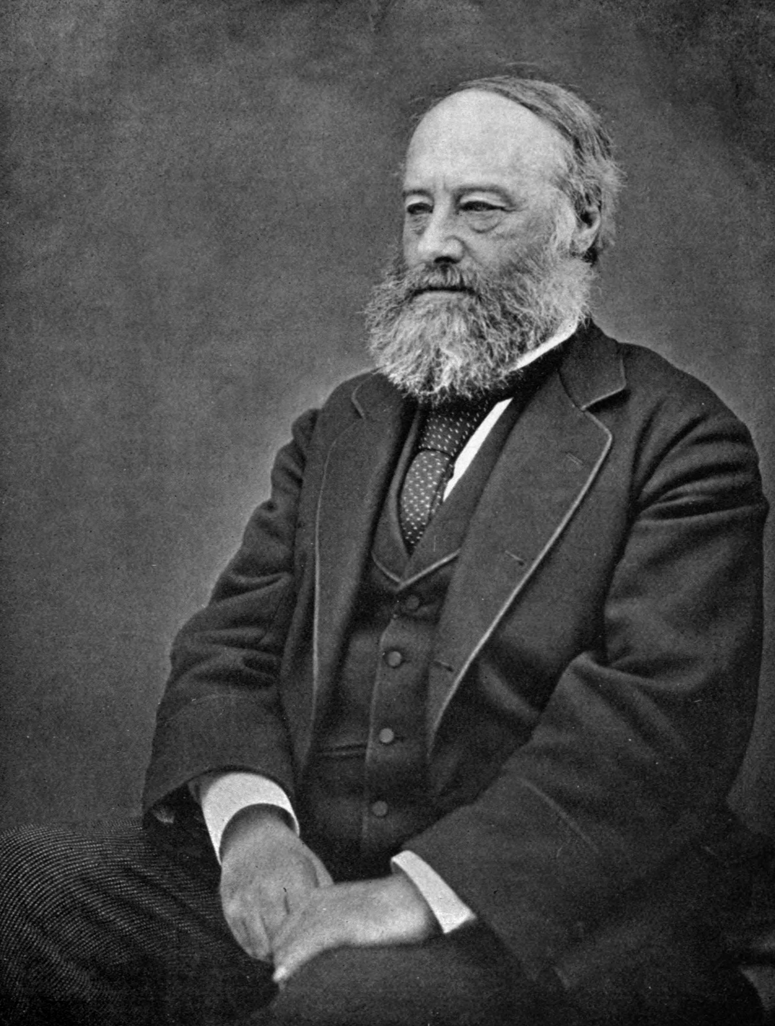
Concept Development
CFU 1
What unit is used to measure energy?
Measuring Energy
The amount of energy possessed by an object is measure in
Joules (J).
The unit is named after an English physicist, James Prescott Joule, who studied heat and energy.
1 Joule is the amount of energy needed to move an object a distance of 1 m, using 1 Newton of force.

Slide 9
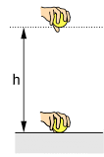
Concept Development
CFU 1
What is the formula used to calculate GPE?
Calculating Gravitational Potential Energy (GPE)
When we lift an object to a height, we use energy and the object gains gravitational potential energy.
The larger the mass and the height, the more energy we use, and the more energy the object gains.
Gravitational potential energy can be calculated using the formula:
GPE = m x g x h
Where m is mass in kilograms
g is gravity (9.8 m/s²) and
h is height in metres
CFU 2
In Joules, how much energy is needed to lift a 1 kg object to a height of 2 m off the ground?
CFU 3
If the mass of the object doubled, what effect would that have on the GPE of the object?

Slide 10
Concept Development
CFU 1
What is the formula used to calculate KE?
Calculating Kinetic Energy (KE)
The energy of motion is kinetic energy.
The larger the mass and the velocity, the more energy the object has.
Kinetic energy can be calculated using the formula:
KE = ½ m x v²
Where m is mass in kilograms
v is velocity in m/s
CFU 2
In Joules, how much energy does a 2 kg object moving at 3 m/s have?

Slide 11

Skill Development/Guided Practice
Reminder:
GPE = m x g x h g = 9.8 m/s² KE = ½ m x v²
Calculating Values Related to Potential and Kinetic Energy
Write down the information you are given. Choose an equation to used based on the information given and rearrange the equation to find your unknown. Substitute values into the equation and solve. Add appropriate units
A 1 kg book is placed on a shelf 2 m from the ground. What is its gravitational potential energy?
1. GPE = ?
h = 1.5 m
m = 1 kg
g = 9.8 m/s²
2. GPE = m x g x h
3. GPE = 1 x 9.8 x 2
GPE = 19.6
4. The book has 19.6 J of gravitational potential energy.

Slide 12
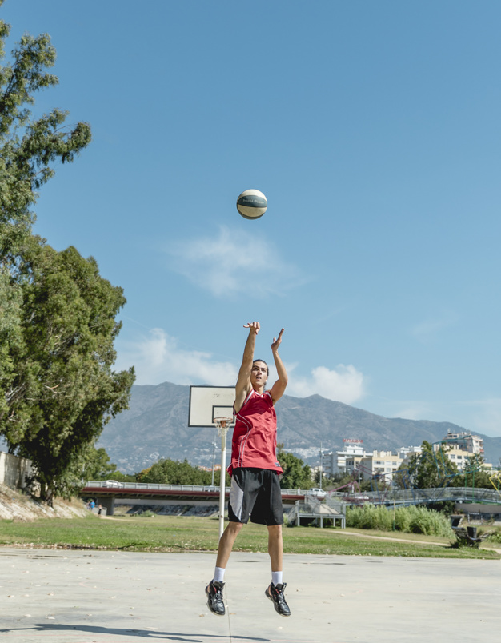
Skill Development/Guided Practice
Reminder:
GPE = m x g x h g = 9.8 m/s² KE = ½ m x v²
Calculating Values Related to Potential and Kinetic Energy
Write down the information you are given. Choose an equation to used based on the information given and rearrange the equation to find your unknown. Substitute values into the equation and solve. Add appropriate units
An object is thrown into the air at a velocity of 10 m/s. If its mass is 2 kg, how much kinetic energy does it have when it leaves the person’s hand?
1. KE = ?
v = 10 m/s
m = 2 kg
2. KE = ½m x v²
3. KE = ½ x 2 x 10²
KE = ½ x 2 x 100
KE = 1 x 100
KE = 100
4. The object has 100 J of kinetic energy when it leaves the person’s hand.

Slide 13
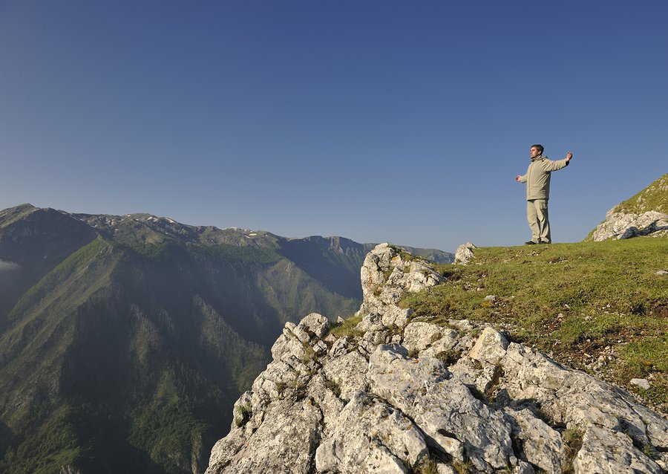
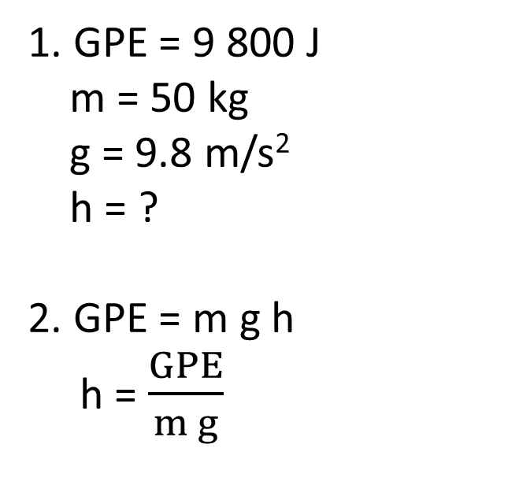
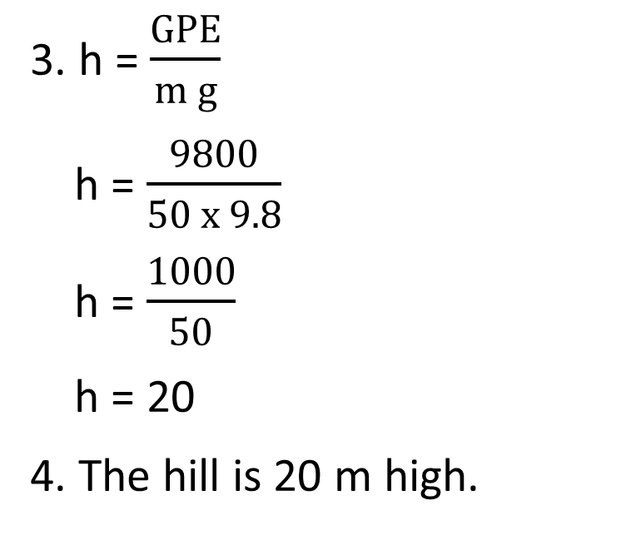
Skill Development/Guided Practice
Reminder:
GPE = m x g x h g = 9.8 m/s² KE = ½ m x v²
Calculating Values Related to Potential and Kinetic Energy
Write down the information you are given. Choose an equation to used based on the information given and rearrange the equation to find your unknown. Substitute values into the equation and solve. Add appropriate units
You are standing on the top of a hill. Your gravitational potential energy is 9800 J and you have a mass of 50 kg. What is the height of the hill?
1. GPE = 9 800 J
m = 50 kg
g = 9.8 m/s²
h = ?
2. GPE = m g h
h = $\frac{GPE}{m g}$
3. h = $\frac{GPE}{m g}$
h = $\frac{9800}{50 x 9.8}$
h = $\frac{1000}{50}$
h = 20
4. The hill is 20 m high.

Slide 14
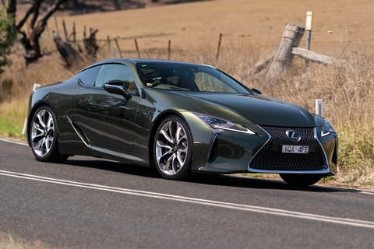
Skill Development/Guided Practice
Reminder:
GPE = m x g x h g = 9.8 m/s² KE = ½ m x v²
Calculating Values Related to Potential and Kinetic Energy
Write down the information you are given. Choose an equation to used based on the information given and rearrange the equation to find your unknown. Substitute values into the equation and solve. Add appropriate units
What is the kinetic energy of a car with a mass of 2000 kg, when moving with a velocity of 4 m/s?
1. KE = ?
m = 2000 kg
v = 4 m/s
2. KE = ½mv²
3. KE = ½mv²
KE = ½ x 2000 x 4²
KE = ½ x 2000 x 16
KE = 1000 x 16
KE = 16 000
4. The car’s kinetic energy is 16 000 J.

Slide 15
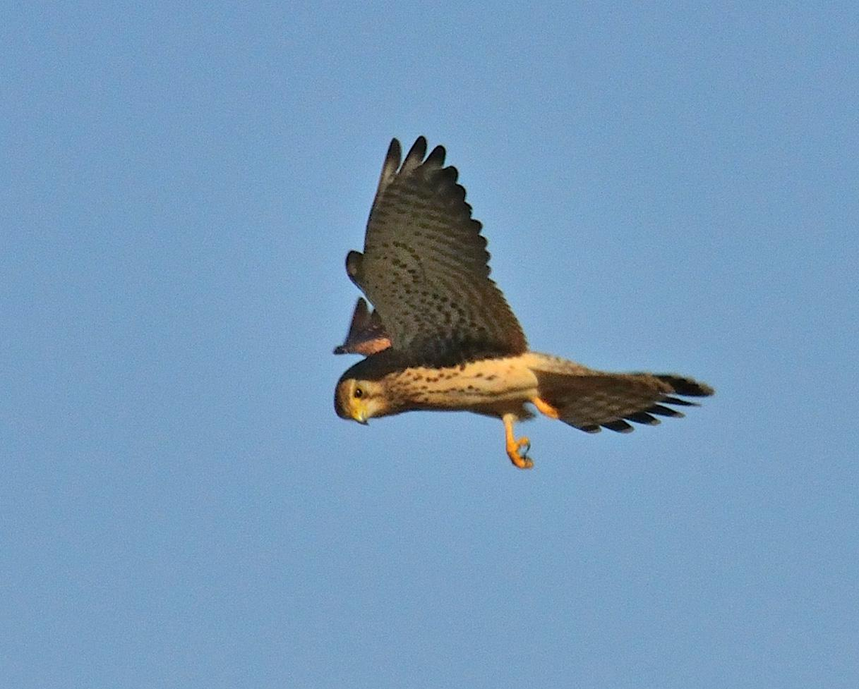
Skill Development/Guided Practice
Reminder:
GPE = m x g x h g = 9.8 m/s² KE = ½ m x v²
Calculating Values Related to Potential and Kinetic Energy
Write down the information you are given. Choose an equation to used based on the information given and rearrange the equation to find your unknown. Substitute values into the equation and solve. Add appropriate units
A bird is hovering 1 km above the ground. If the bird has a mass of 1 kg, what is its gravitational potential energy?
1. GPE = ?
h = 1 km = 1 000 m
m = 1 kg
g = 9.8 m/s²
2. GPE = m g h
3. GPE = m g h
GPE = 1 x 9.8 x 1 000
GPE = 9 800
4. The bird’s gravitational potential energy is 9 800 J.

Slide 16
Relevance
Understanding the relationship between gravitational potential energy and kinetic energy will help you explain energy transformations in falling objects.
It will also help you explain why the velocity of objects increases as they fall or roll down a hill, as they lose gravitational potential energy and gain kinetic energy.

Slide 17
Skill Closure
Write the equation used to calculate the gravitational potential energy of an object.
Skill Closure
Write the equation used to calculate the kinetic energy of an object.
Reminder:
GPE = m x g x h g = 9.8 m/s² KE = ½ m x v²
Skill Closure
A box with a mass of 4 kg is placed on a coffee table that is 1 m high. How much energy is possessed by the box?

Slide 18
Independent Practice
Complete the GPE and KE calculations worksheet on your device or a paper copy.

